Slide 1
Lifeskills on habits and addictions
with Sana Barada
Dott.ssa Sana Barada - www.sanafirenze.com

Slide 2
What are the similarities between addictions to substances, food, electronics, relationships, and thinking patterns?
Key Concepts in Addiction Development:
1. Instantaneous gratification seeking / pleasure
2. Repetition of behavior
3. Tolerance increase
4. Polarization of focus
5. Disconnection between judgment and decision-making
Dott.ssa Sana Barada - www.sanafirenze.com

Slide 3
My work in addiction field develops in two ways:
One on One
Prevention and maintenance
Dott.ssa Sana Barada - www.sanafirenze.com

Slide 4
One-on-One
- It is based on personalized/tailored work with patients to help them abandon what, by creating pleasure, leads them in some cases to dysfunctional behavior that can be classified as "abuse", despite being aware of the negative consequences that this behavior generates.
- It is an improvement in lifestyle through the elimination of addictions not only to substances such as drugs, alcohol, nicotine, etc. but also from food, from electronics, from a partner, sex, etc
Dott.ssa Sana Barada - www.sanafirenze.com

Slide 5
One on One
In my sessions I have a new and different approach compared to the classic therapeutic approach usually used by a psychiatrist and/or psychologist
As a clinical pharmacologist I work on understanding the interaction of substances with the organism and the consequent effects generated with the consolidation of certain habits
The specific study in the field of addictions led me to develop understanding even where there were no substances but behaviors, behaviors that lead to the same effect.
Dott.ssa Sana Barada - www.sanafirenze.com

Slide 6
How I help my patients:
By increasing awareness and understanding and giving them real "training" on these issues, in order to make them "experts" of their case
Experiencing the situation no longer as an "illness" but rather as a "personal strategy" for coping with old experiences and accompanying them, thanks to the new tools acquired, in the "elaboration" of these behaviors in a more 'functional' dimension aimed at their resolution.
Dott.ssa Sana Barada - www.sanafirenze.com

Slide 7
Patience, embracement, empathy and depth in listening
They are fundamental and characterizing aspects of my sessions leading people to open up completely with serenity and trust. Very important aspects indeed that I’d rather call indispensable in this connection about to be created.
In addition to my 14 years of study and many years of work, I believe that my passion and also my personal experience with bulimia and anorexia, which transformed then into a great strength by creating a healthy and peaceful life, are the real and very strong push and motivation in my attitude to helping those going through these "difficulties".
Dott.ssa Sana Barada - www.sanafirenze.com

Slide 8
One on One Support
For those who are trying to lose weight while undertaking a pharmacological path, I accompany this therapy with an integrated support that makes it truly effective while maintaining stable results over time.
Dott.ssa Sana Barada - www.sanafirenze.com

Slide 9
Prevention and Maintenance
‘Wellbeing’ course for learning skills, ‘Lifeskills’, to become increasingly aware and capable of:
Changing habits, not only linked to the way of acting, but also to the way of thinking and approaching.
Enhancing your autonomy (self-leadership), well-being and productivity.
Dott.ssa Sana Barada - www.sanafirenze.com

Slide 10
Two cycles of four meetings
First cycle - Meetings’ topics
Tools for change: how to eliminate bad habits and introduce healthy new ones
  Self-awareness
  Empathy
  Interpersonal relationships
  Communication
Dott.ssa Sana Barada - www.sanafirenze.com

Slide 11
Second cycle - Meetings’ topics
  Decision Making
  Problem Solving
  Creativity
  Critical thinking
Dott.ssa Sana Barada - www.sanafirenze.com

Slide 12
Let me guide you through how these life skills can be both helpful and necessary to create the changes you seek!!
For example, let’s focus on the life skill of Positive Interpersonal Relationships and explore how it plays a key role in personal growth and transformation.
Dott.ssa Sana Barada - www.sanafirenze.com

Slide 13
Definition of Positive Interpersonal Relationships
These are functional relationships, based on the expression of needs, feelings, and opinions, and built on mutual respect.
Why are they fundamental in daily life?
Social needs, such as relationships and a sense of belonging, are essential in Maslow’s hierarchy. Only by fulfilling these needs can an individual progress toward self-actualization and reach their full potential.
Dott.ssa Sana Barada - www.sanafirenze.com

Slide 14
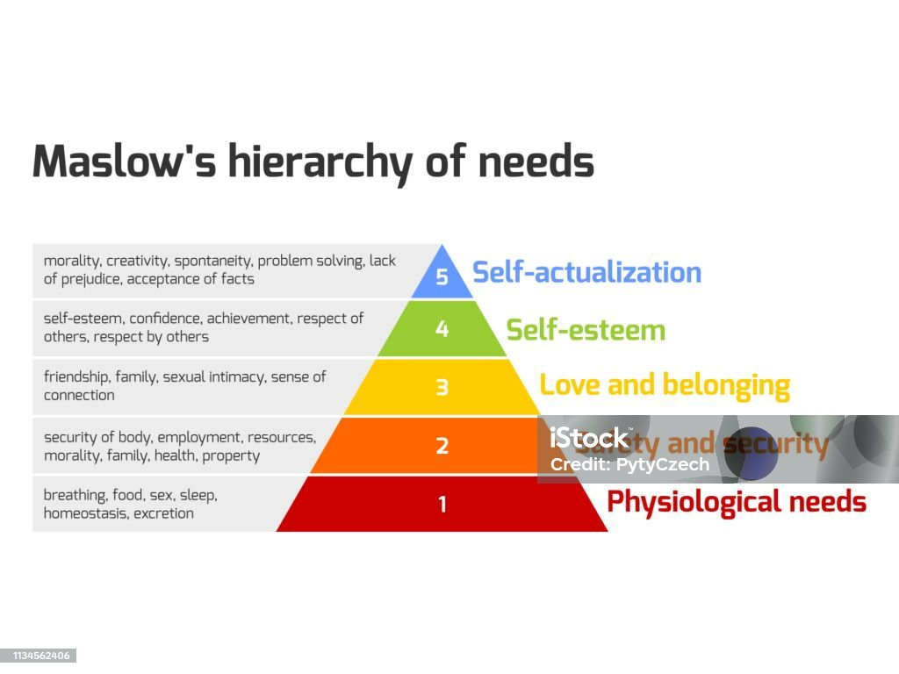
Dott.ssa Sana Barada - www.sanafirenze.com

Slide 15
The Importance of Positive Interpersonal Relationships in Personal Growth
The opposite of addiction is not sobriety, it’s connection!
Addiction is often characterized by isolation:
Secretly engaging in behaviors like binge eating or drinking.
Withdrawing from work, school, or social activities to continue harmful habits.
Dott.ssa Sana Barada - www.sanafirenze.com

Slide 16
Building positive interpersonal relationships is NOT ONLY key to breaking bad habits but also to developing new healthy ones:
Encouragement and accountability from others can support long-term lifestyle changes.
Sharing goals with friends or family fosters motivation and commitment.
Positive relationships provide emotional support and reduce stress, making it easier to form sustainable habits.
Surrounding yourself with people who have similar healthy goals can inspire you to adopt better routines.
Dott.ssa Sana Barada - www.sanafirenze.com

Slide 17
Who’s Sana Barada?
website: www.sanafirenze.com
I’m a clinical pharmacist from the Lebanese American University (LAU) with a doctorate in applied pharmacology and pharmacovigilance. In 2012, I attended the International Program on Addiction Studies, IPAS, a master's degree participated by Virginia Commonwealth University, King's College London, the University of Adelaide, and recommended by NIDA, the American National Institute on Drug Abuse. Over the years I have conceived and developed a series of particularly significant initiatives and projects, also presented to the WHO (World Health Organization), with the United Nations, the Italian Cooperation in Lebanon, and various NGOs, operating both in Italy and in the Middle East. I have been working as a freelancer since 2015, helping people with problems related to various addictions. I’m a speaker at conferences in the field of addictions, eating disorders and public health and author of scientific publications in national magazines. I have achieved international recognition for my scientific contributions.
Proud mother of 3 wonderful children and author of the book 'Leggera e Invisibile'.
I speak four languages: English, Italian, Arabic and French
Dott.ssa Sana Barada - www.sanafirenze.com

Slide 18
How to Book an Appointment with Dr. Barada:
1. WhatsApp: +39 3335467043 (Fastest way to reach out)
2. Email: info@sanafirenze.com (For detailed inquiries)
3. Website: www.sanafirenze.com (For additional information)
Follow us on social media for updates and wellness tips:
• Facebook: sanafirenze
Instagram: @dottoressa.sana.barada
Dott.ssa Sana Barada - www.sanafirenze.com

